Slide 1
Amazon Products
Lachandra Ash
November 25, 2022

Slide 2

Introduction
Amazon's reputation for offering highly reliable product recommendations online has earned the company much praise.
Artificial intelligence algorithms and machine learning are used to enhance the shopping experience and boost revenue.
When a consumer visits Amazon, they will be presented with a list of suggested items based on Amazon's sophisticated analysis and prediction of the user's buying interests

Slide 3

Agenda
Amazon needs dependable product recommendations for their consumers.
Amazon would like to boost their profits from their products.
Amazon wants their reviews, prices, and ratings to be analyzed.

Slide 4
Amazon’s History
Jeff Bezos founded Amazon in 1994
In the 25 years since its founding, Amazon has become the dominant eCommerce platform, with 2019 expected to bring in a net profit of up to $ 280.5 billion.
Amazon's worldwide success may be attributed in large part to the company's unique business strategy and well-considered management, but also to the platform's ongoing iteration and the introduction of fresh ideas.

Slide 5
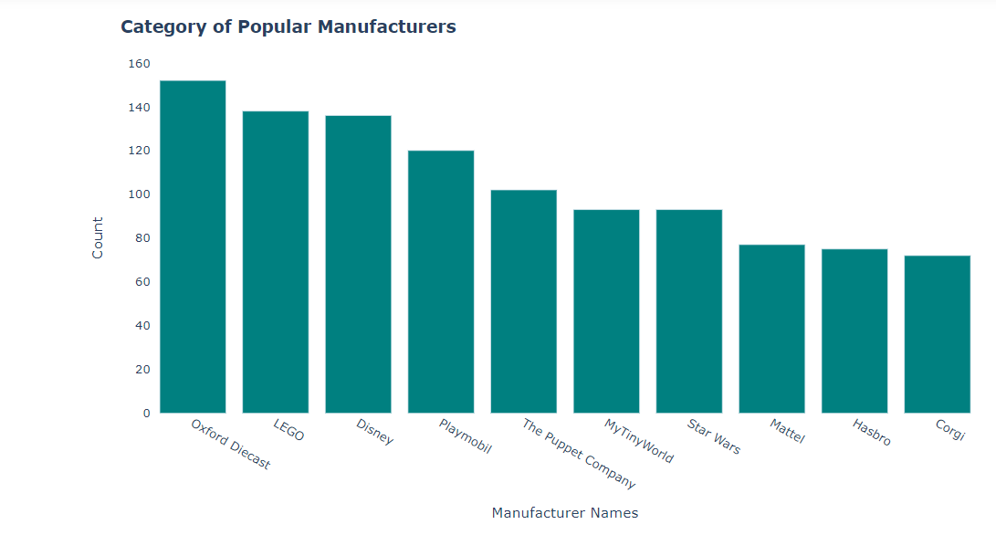
Category of Popular Manufacturers
The oxford diecast manufacturer is the most popular manufacturer.
Gorgi, Hasbro, and Mattel are the least popular manufacturers.

Slide 6
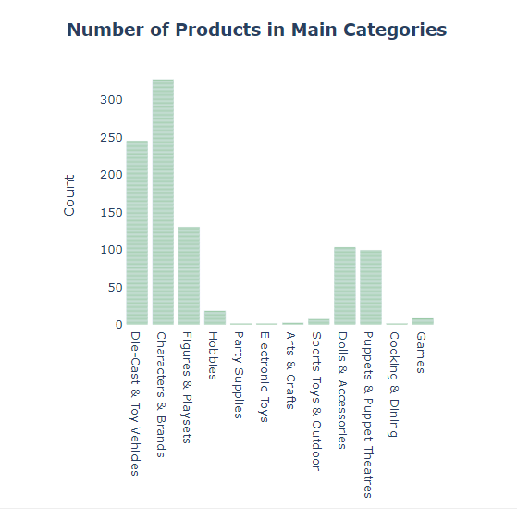
Main Categories
The characters and brands had the highest number of products.
The party supplies, electronic toys, arts & crafts, sports toys & outdoor, cooking & dinning, and games had the least number of products.

Slide 7
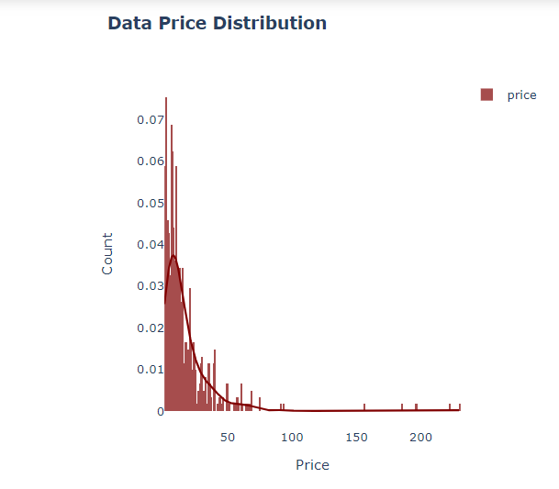
Data Price Distribution
The data price distribution plot is right skewed and there are outliers within the plot.

Slide 8
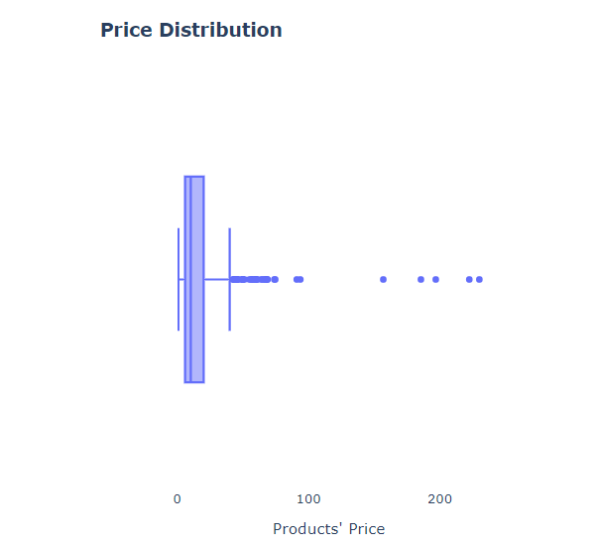
Price Distribution
The boxplot was created to check for outliers within the products’ price.
There are 5.95 outliers in quartile 1, 10.37 outliers in quartile 2, and 20.12 outliers in quartile 3.

Slide 9
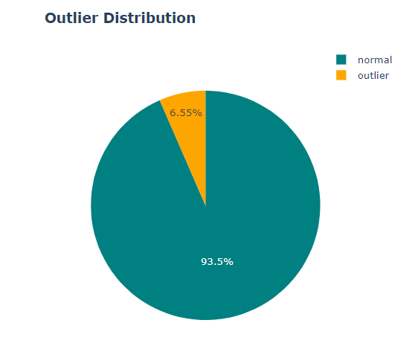
Outlier Distribution
The outlier distribution pie chart displays 93.5% of normal outlier price, and 6.55% outliers within the outlier price.

Slide 10
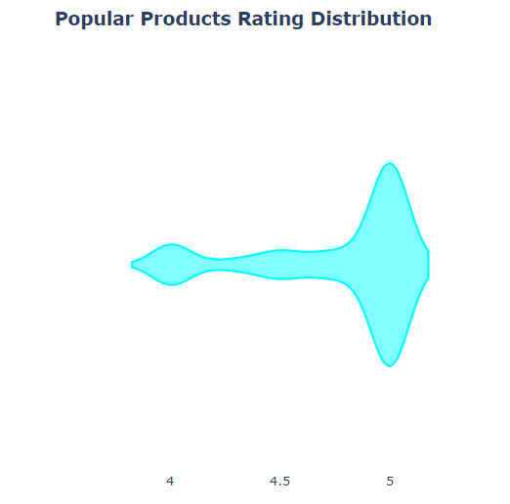
Popular Products Rating Distribution
The most popular products had 5.2 ratings, and the least popular products had 3.8 ratings.

Slide 11
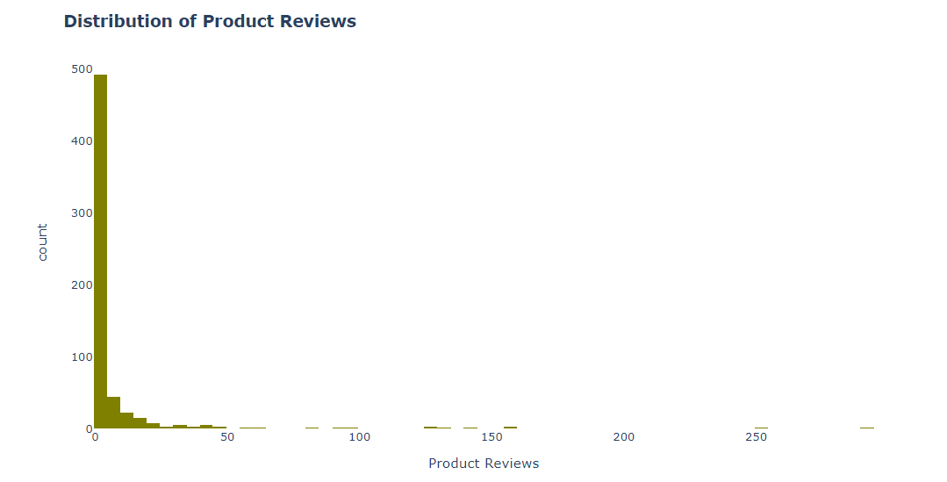
Product Reviews Distribution
One product received the greatest number of reviews.
Most products received the least number of reviews.

Slide 12
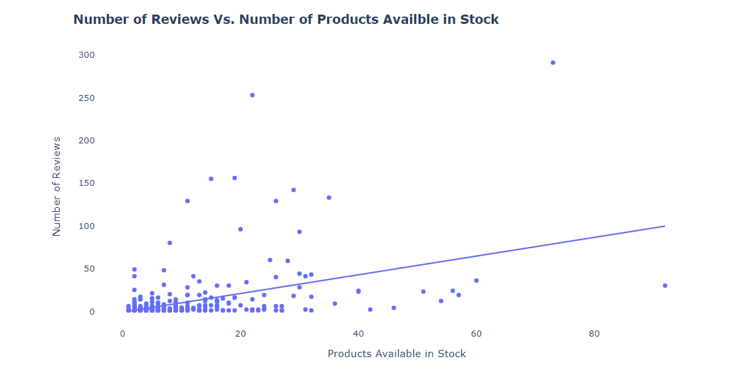
Reviews Vs. Products Available in Stock
The highest number of products available in stock has thirty reviews.
The highest number of reviews has nineteen products available in stock.
The least number of products available in stock has one review.

Slide 13
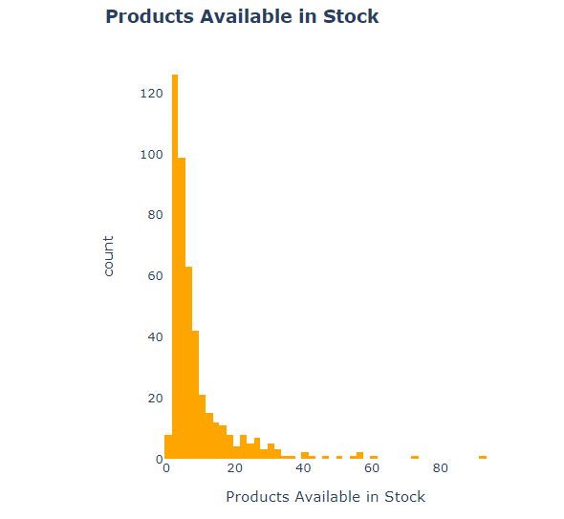
Products Available in Stock
Two to three products are mostly in stock.

Slide 14

Conclusion
The products that were priced below fifty dollars were popular.
The Disney and Lego manufacturers contained outlier price.
The character and brand sub-category have outlier price.
The used items were within the outlier price.
The 5-star rating range contained the highest number of popular brands.
There was only one product with the highest number of reviews.
The highest number of products had the least number of reviews.

